Slide 1
AE Waveform Recording and Processing

Slide 2
Spectrum
Recording

Slide 3
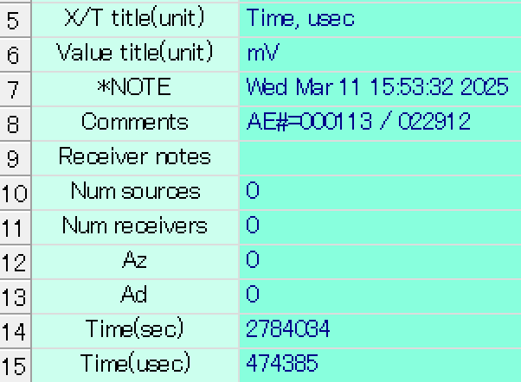
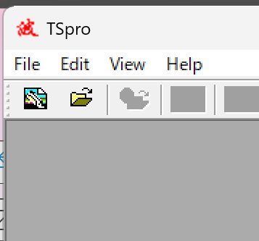
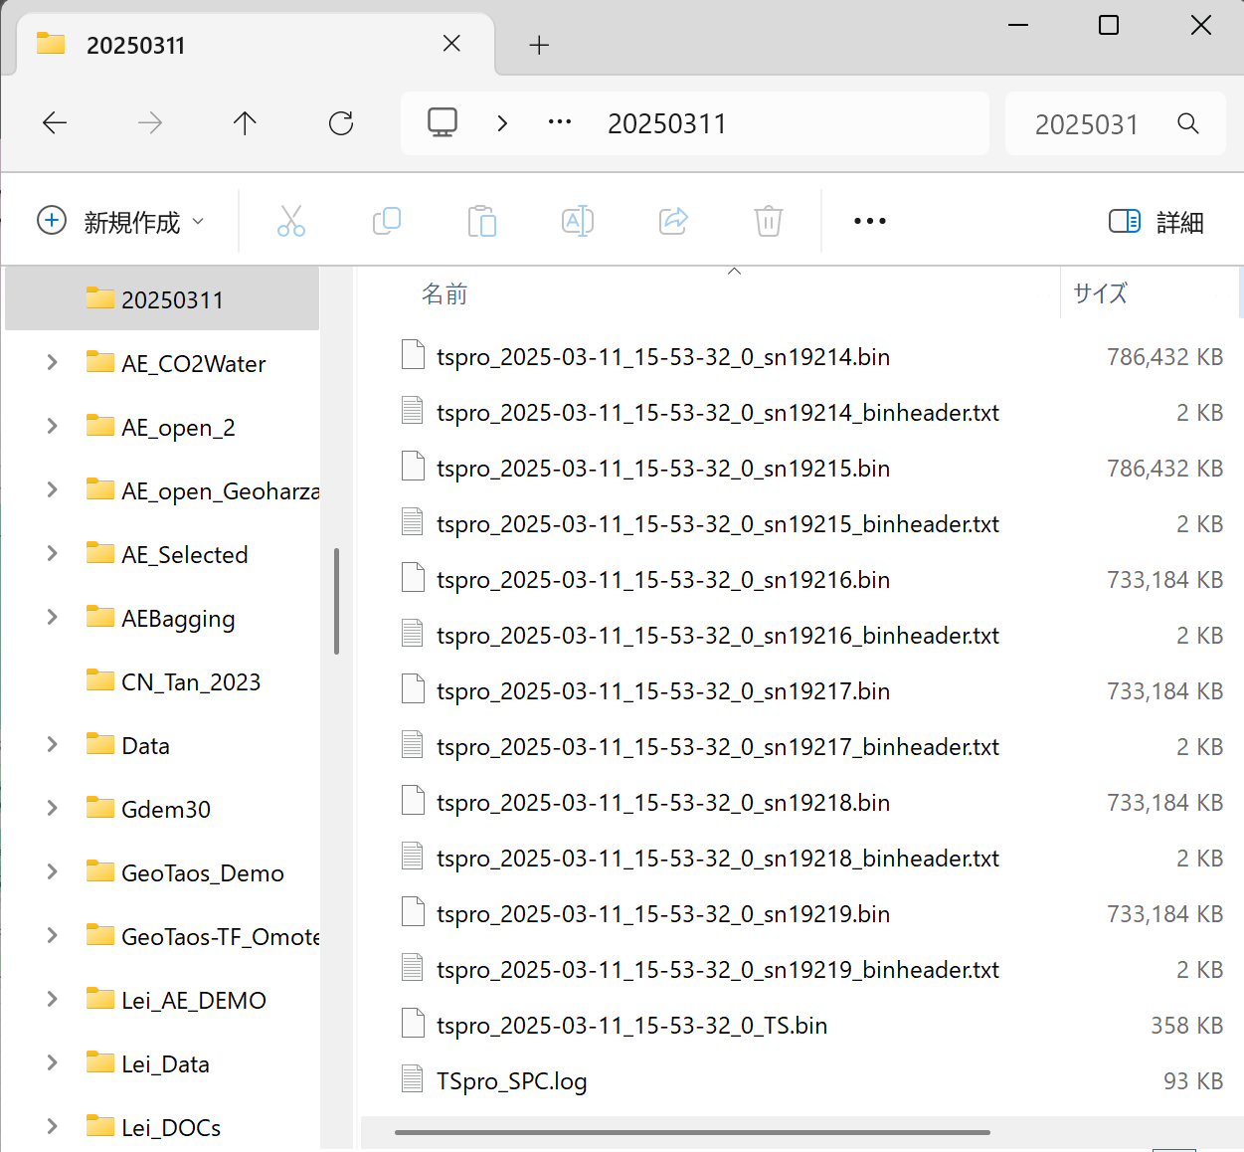
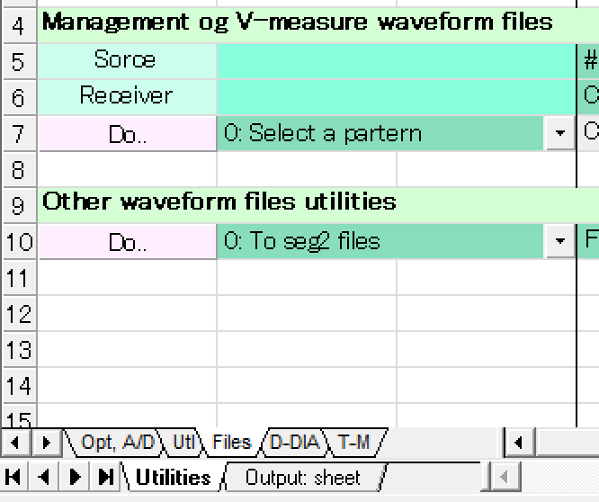
Playback of BIN files
File management
Total number of event
②
①
To SEG2 files

Slide 4
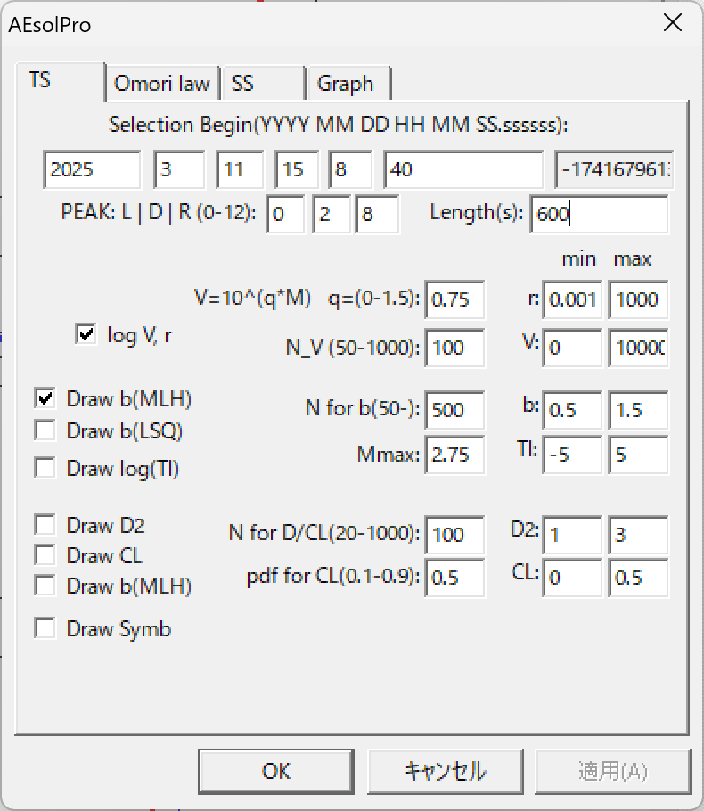
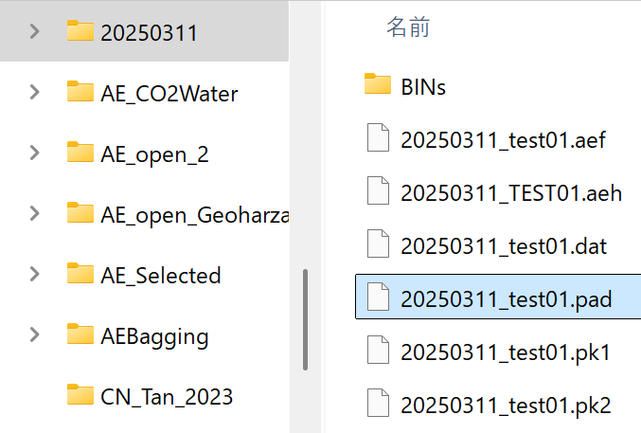
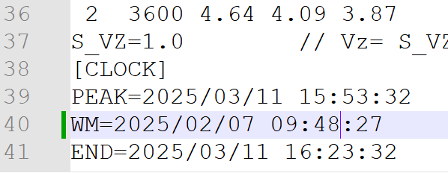
AEsolPro
②
①

Slide 5
表示時間AEsolPro
開始時間を指定
時間軸の長さを指定
①
②

Slide 6
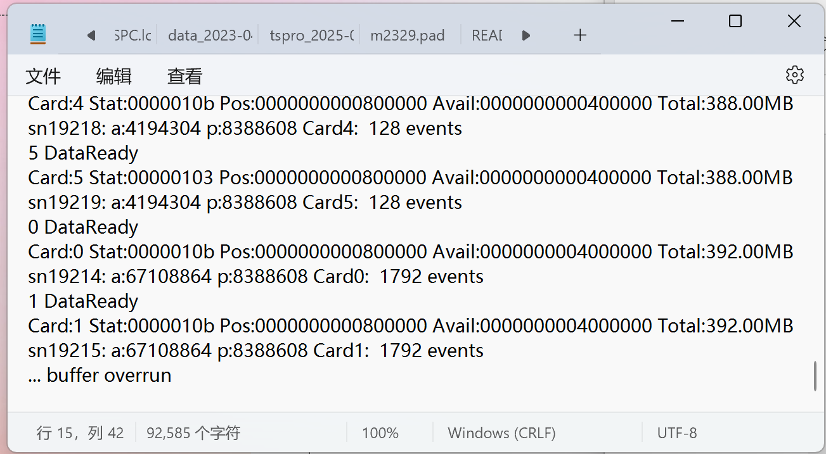
Why buffer overrun
Length 4096S/Chn ->8192 B
FiFO-Multi 2048 !<=8192 for Win32
On-board Buffer 4GS -> 65536 Events
uint64 llDataBufLen = 4096 * 2048 * 2 * 4;
uint64 llDataNotify = 4096 * 128 * 2 * 4;
理解できないのは なぜオンボードバッファー余裕あるのに
Buffer Overrunになる？
Use multi mode M=65536 events
Is the best choice right now!?

